Slide 1

PYTHON PROGRAMMING & DATA SCIENCE

Slide 2
Descriptive Statistics
Descriptive Statistics is the default process in Data analysis.
Exploratory Data Analysis (EDA) is not complete without a Descriptive Statistic analysis.
Descriptive Statistics is divided into two parts:
Measure of Central Data points and
Measure of Dispersion.
1. Measure of Central Data points:
The following operations are performed under Measure of Central Data points
Count
Mean
Mode
Median

Slide 3
Descriptive Statistics
2. Measure of Dispersion
The following operations are performed under Measure of Dispersion
Range
Percentiles (or) Quartiles
Standard deviation
Variance
Skewness

Slide 4
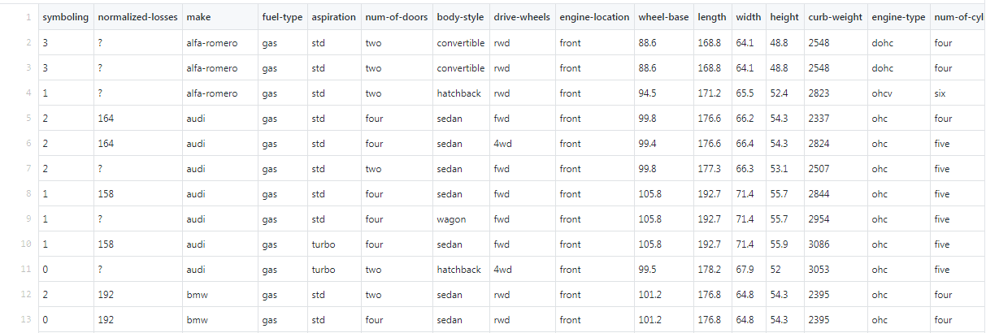
Descriptive Statistics
Example:
Consider a file:
Data.csv
It contains 206 lines and 26 columns
Before starting descriptive statistics analysis complete the data collection and cleaning process.

Slide 5
Descriptive Statistics
Data Collection:
# loading data set as Pandas dataframe
import pandas as pd
df = pd.DataFrame()
df = pd.read_csv("https://raw.githubusercontent.com/PacktPublishing/hands-on-exploratory-data-analysis-with-python/master/Chapter%205/data.csv")
df.head()
It contains 206 lines and 26 columns
Before starting analysis complete the data collection and cleaning process.

Slide 6
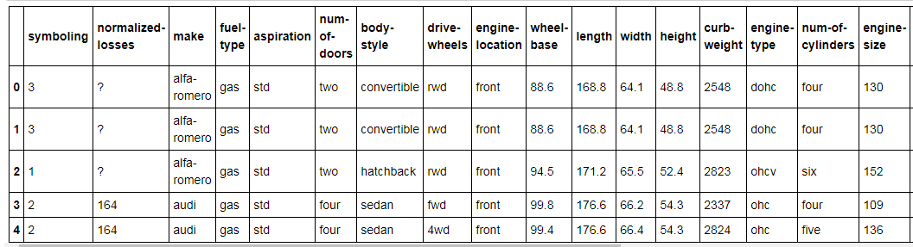
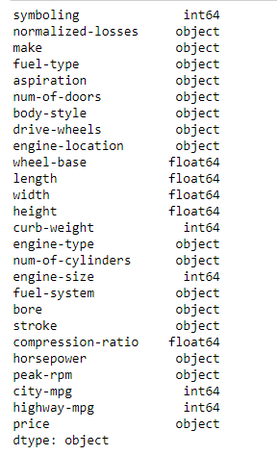
Descriptive Statistics
Data Collection:
df.dtypes
It contains 206 lines and 26 columns
Before starting analysis complete the data collection and cleaning process.

Slide 7
Descriptive Statistics
Data Cleaning
# Find out the number of values which are not numeric
df['price'].str.isnumeric().value_counts()
# List out the values which are not numeric
df['price'].loc[df['price'].str.isnumeric() == False]
#Setting the missing value to mean of price and convert the datatype to integer
price = df['price'].loc[df['price'] != '?']
pmean = price.astype(str).astype(int).mean()
df['price'] = df['price'].replace('?',pmean).astype(int)
df.dtypes
It contains 206 lines and 26 columns
Before starting analysis complete the data collection and cleaning process.

Slide 8
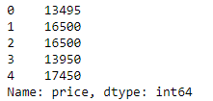
Descriptive Statistics
Data Cleaning
df['price'].head()
# Cleaning the horsepower losses field
df['horsepower'].str.isnumeric().value_counts()
horsepower = df['horsepower'].loc[df['horsepower'] != '?']
hpmean = horsepower.astype(str).astype(int).mean()
df['horsepower'] = df['horsepower'].replace('?',hpmean).astype(int)
df.dtypes
It contains 206 lines and 26 columns
Before starting analysis complete the data collection and cleaning process.

Slide 9
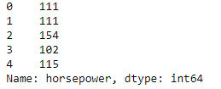
Descriptive Statistics
Data Cleaning
df['horsepower'].head()
# Cleaning the Normalized losses field
df[df['normalized-losses']=='?'].count()
nl=df['normalized-losses'].loc[df['normalized-losses'] !='?'].count()
nmean=nl.astype(str).astype(int).mean()
df['normalized-losses'] = df['normalized-losses'].replace('?',nmean).astype(int)
It contains 206 lines and 26 columns
Before starting analysis complete the data collection and cleaning process.

Slide 10
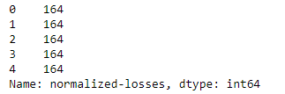
Descriptive Statistics
Data Cleaning
df['normalized-losses'].head()
# cleaning the bore
# Find out the number of invalid value
df['bore'].loc[df['bore'] == '?']
# Replace the non-numeric value to null and convert the datatype
df['bore'] = pd.to_numeric(df['bore'],errors='coerce')

Slide 11
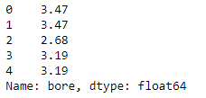
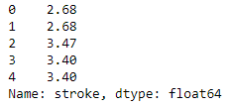
Descriptive Statistics
Data Cleaning
df.bore.head()
# Cleaning the column stoke
df['stroke'] = pd.to_numeric(df['stroke'],errors='coerce')
df['stroke'].head()

Slide 12
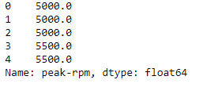
Descriptive Statistics
Data Cleaning
# Cleaning the column peak-rpm
df['peak-rpm'] = pd.to_numeric(df['peak-rpm'],errors='coerce')
df['peak-rpm'].head()

Slide 13
Descriptive Statistics
Data Cleaning
# Cleaning the Column num-of-doors data
# remove the records which are having the value '?'
df['num-of-doors'].loc[df['num-of-doors'] == '?']
df= df[df['num-of-doors'] != '?']
df['num-of-doors'].loc[df['num-of-doors'] == '?']

Slide 14
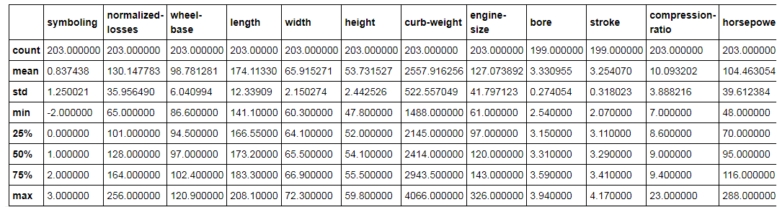
Descriptive Statistics
df.describe()

Slide 15
Descriptive Statistics
computing Measure of central tendency
Count
It calculates the total count of numerical column data (or) each category of the categorical variables.
# get column height from df
height =df["height"]
print(height)
Output:
0 48.8
1 48.8
2 52.4
3 54.3
4 54.3
...
200 55.5
201 55.5
202 55.5
203 55.5
204 55.5
Name: height, Length: 203, dtype: float64

Slide 16


Descriptive Statistics
computing Measure of central tendency
Mean
The Sum of values present in the column divided by total rows of that column is known as mean.
It is also known as average.

Slide 17
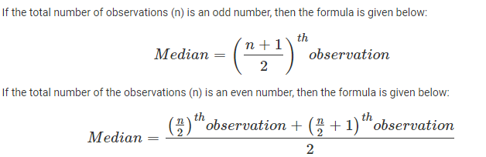
Descriptive Statistics
computing Measure of central tendency
Median
The center value of an attribute is known as a median.
The median value divides the data points into two parts. That means 50% of data points are present above the median and 50% below.

Slide 18
Descriptive Statistics
computing Measure of central tendency
Mode
The mode is that data point whose count is maximum in a column.
There is only one mean and median value for each column. But, attributes can have more than one mode value
#Calculating mean, median, mode of dataset height
mean = height.mean()
median =height.median()
mode = height.mode()
print(mean , median, mode)
Output:
53.73152709359609 54.1 0 50.8 dtype: float64

Slide 19
Descriptive Statistics
computing Measure of central tendency
For categorical variables which has discrite values.
categorical data can be summarized by using the function value_counts().
#summarize categories of drive-wheels
drive_wheels_count =df["drive-wheels"].value_counts()
print(drive_wheels_count)
Output:
fwd 118 rwd 764 wd 9 Name: drive-wheels, dtype: int64

Slide 20
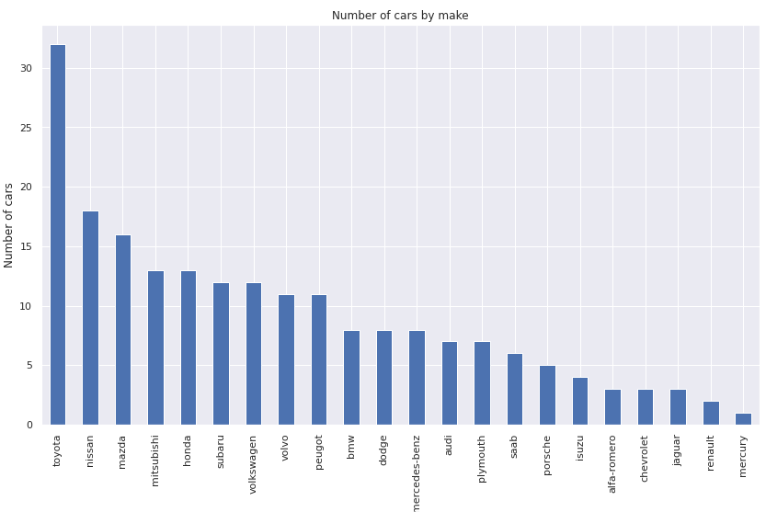
Descriptive Statistics
computing Measure of central tendency
Example 2
import matplotlib.pyplot as plt
df.make.value_counts().nlargest(30).plot(kind='bar', figsize=(14,8))
plt.title("Number of cars by make")
plt.ylabel('Number of cars')
plt.xlabel('Make of the cars');

Slide 21
Descriptive Statistics
Measures of Dispersion
Range
The difference between the max value to min value in a column is known as the range.
Standard Deviation
The standard deviation value tells us how much all data points deviate from the mean value.
The standard deviation is affected by the outliers because it uses the mean for its calculation.

Slide 22
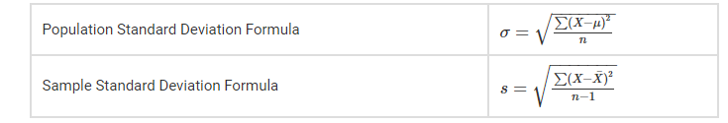
Descriptive Statistics
Measures of Dispersion
Formulas for Standard Deviation
Notations for Standard Deviation
σ = Standard Deviation
x_{i} = Terms Given in the Data
x̄ = Mean
n = Total number of Terms

Slide 23
Descriptive Statistics
Measures of Dispersion
Standard Deviation
Example for standard deviation
#standard deviation of data set using std() function
std_dev =df.std()
print(std_dev)
# standard deviation of the specific column
sv_height=df.loc[:,"height"].std()
print(sv_height)
2.442525704031867
Output:
symboling 1.250021
normalized-losses 35.956490
wheel-base 6.040994
length 12.339090
width 2.150274
height 2.442526
curb-weight 522.557049
engine-size 41.797123
bore 0.274054
stroke 0.318023
compression-ratio 3.888216
horsepower 39.612384
peak-rpm 479.820136
city-mpg 6.529812
highway-mpg 6.874645
price 7898.957924
dtype: float64

Slide 24
Descriptive Statistics
Measures of Dispersion
Variance
Variance is the square of standard deviation.
Variance = (Standard deviation)²= σ²
In the case of outliers, the variance value becomes large and noticeable.

Slide 25
Descriptive Statistics
Measures of Dispersion
Variance
Example for standard variance
# variance of data set using var() functionvariance=df.var()
print(variance)
#variance of the specific column
var_height=df.loc[:,"height"].var()
print(var_height)
5.965931814856368
Output:
symboling 1.562552e+00
normalized-losses 1.292869e+03
wheel-base 3.649361e+01l
ength 1.522531e+02
width 4.623677e+00
height 5.965932e+00
curb-weight 2.730659e+05
engine-size 1.746999e+03
bore 7.510565e-02
stroke 1.011384e-01
compression-ratio 1.511822e+01
horsepower 1.569141e+03
peak-rpm 2.302274e+05
city-mpg 4.263844e+01
highway-mpg 4.726074e+01
price 6.239354e+07
dtype: float64

Slide 26
Descriptive Statistics
Measures of Dispersion
Skewness
Ideally, the distribution of data should be in the shape of Gaussian (bell curve).
But practically, data shapes are skewed or have asymmetry. This is known as skewness in data.
Formula for skewness is:
Skew = 3 * (Mean – Median) / Standard Deviation
Skewness value can be negative (left) skew or positive (right) skew. Its value should be close to zero.

Slide 27
Descriptive Statistics
Measures of Dispersion
Skewness
Example for skewness
df.skew()
# skewness of the specific column
df.loc[:,"height"].skew()
0.06413448813322854
Output:
symboling 0.204275 normalized-losses 0.209007 wheel-base 1.041170
length 0.154086
width 0.900685
height 0.064134
curb-weight 0.668942
engine-size 1.934993
bore 0.013419
stroke -0.669515
compression-ratio 2.682640 horsepower 1.391224
peak-rpm 0.073094
city-mpg 0.673533
highway-mpg 0.549104
price 1.812335
dtype: float64

Slide 28
Descriptive Statistics
Measures of Dispersion
Percentiles or Quartiles
Column values can be spread by calculating the summary of several percentiles.
Median is also known as the 50th percentile of data.
Here is a different percentile.
The minimum value equals to 0th percentile.
The maximum value equals to 100th percentile.
The first quartile equals to 25th percentile.
The third quartile equals to 75th percentile.

Slide 29
Descriptive Statistics
Measures of Dispersion
Quartiles
It divides the data set into four equal points.
First quartile = 25th percentile
Second quartile = 50th percentile (Median)
Third quartile = 75th percentile
Based on the quartile, there is a another measure called inter-quartile range that also measures the variability in the dataset. It is defined as:
IQR = Q3 - Q1
IQR is not affected by the presence of outliers.

Slide 30
Descriptive Statistics
Measures of Dispersion
Quartiles
Example 1:
price = df.price.sort_values()
Q1 = np.percentile(price, 25)
Q2 = np.percentile(price, 50)
Q3 = np.percentile(price, 75)
IQR = Q3 - Q1
IQR
8718.5

Slide 31
Descriptive Statistics
Measures of Dispersion
Quartiles
Example 2:
#calculating 30th percentile of heights in dataset
height = df["height"]
percentile = np.percentile(height, 50,)
print(percentile)
54.1

Slide 32
Thank You

